Slide 1
Writing TLA+ Specifications
Lecturer: Ngo Huy Bien
Software Engineering Department
Faculty of Information Technology
VNUHCM - University of Science
Ho Chi Minh City, Vietnam
nhbien@fit.hcmus.edu.vn

Slide 2

Objectives

Slide 3

Contents
The Transition Commit Problem
The Two-Phase Commit Protocol

Slide 4

References
Leslie Lamport (2002). Specifying Systems - The TLA+ Language and Tools for Hardware and Software Engineers. Addison-Wesley Professional.
https://lamport.azurewebsites.net/video/videos.html
https://lamport.azurewebsites.net/tla/tla.html
https://foundation.tlapl.us/
https://lamport.azurewebsites.net/pubs/pubs.html

Slide 5
The Transaction Commit Problem
Goal: Atomic operations.
Resource managers.

Slide 6
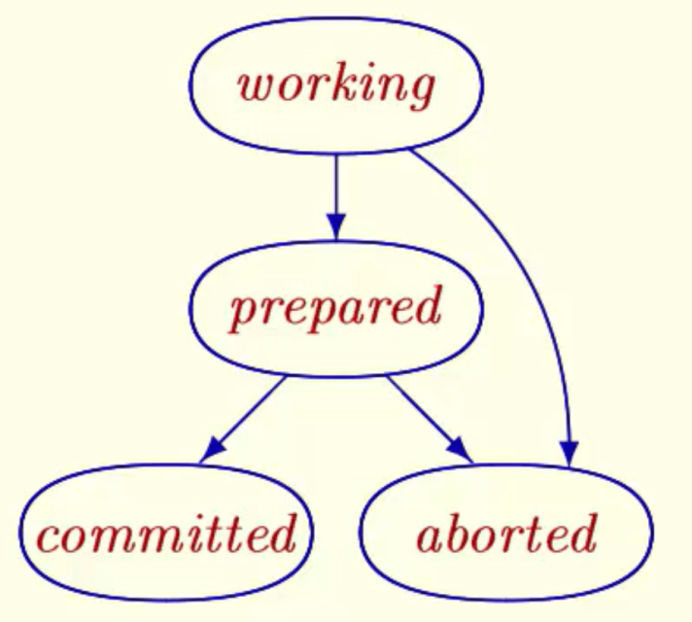
Possible States and Steps
Working
Prepared
Committed
Aborted

Slide 7
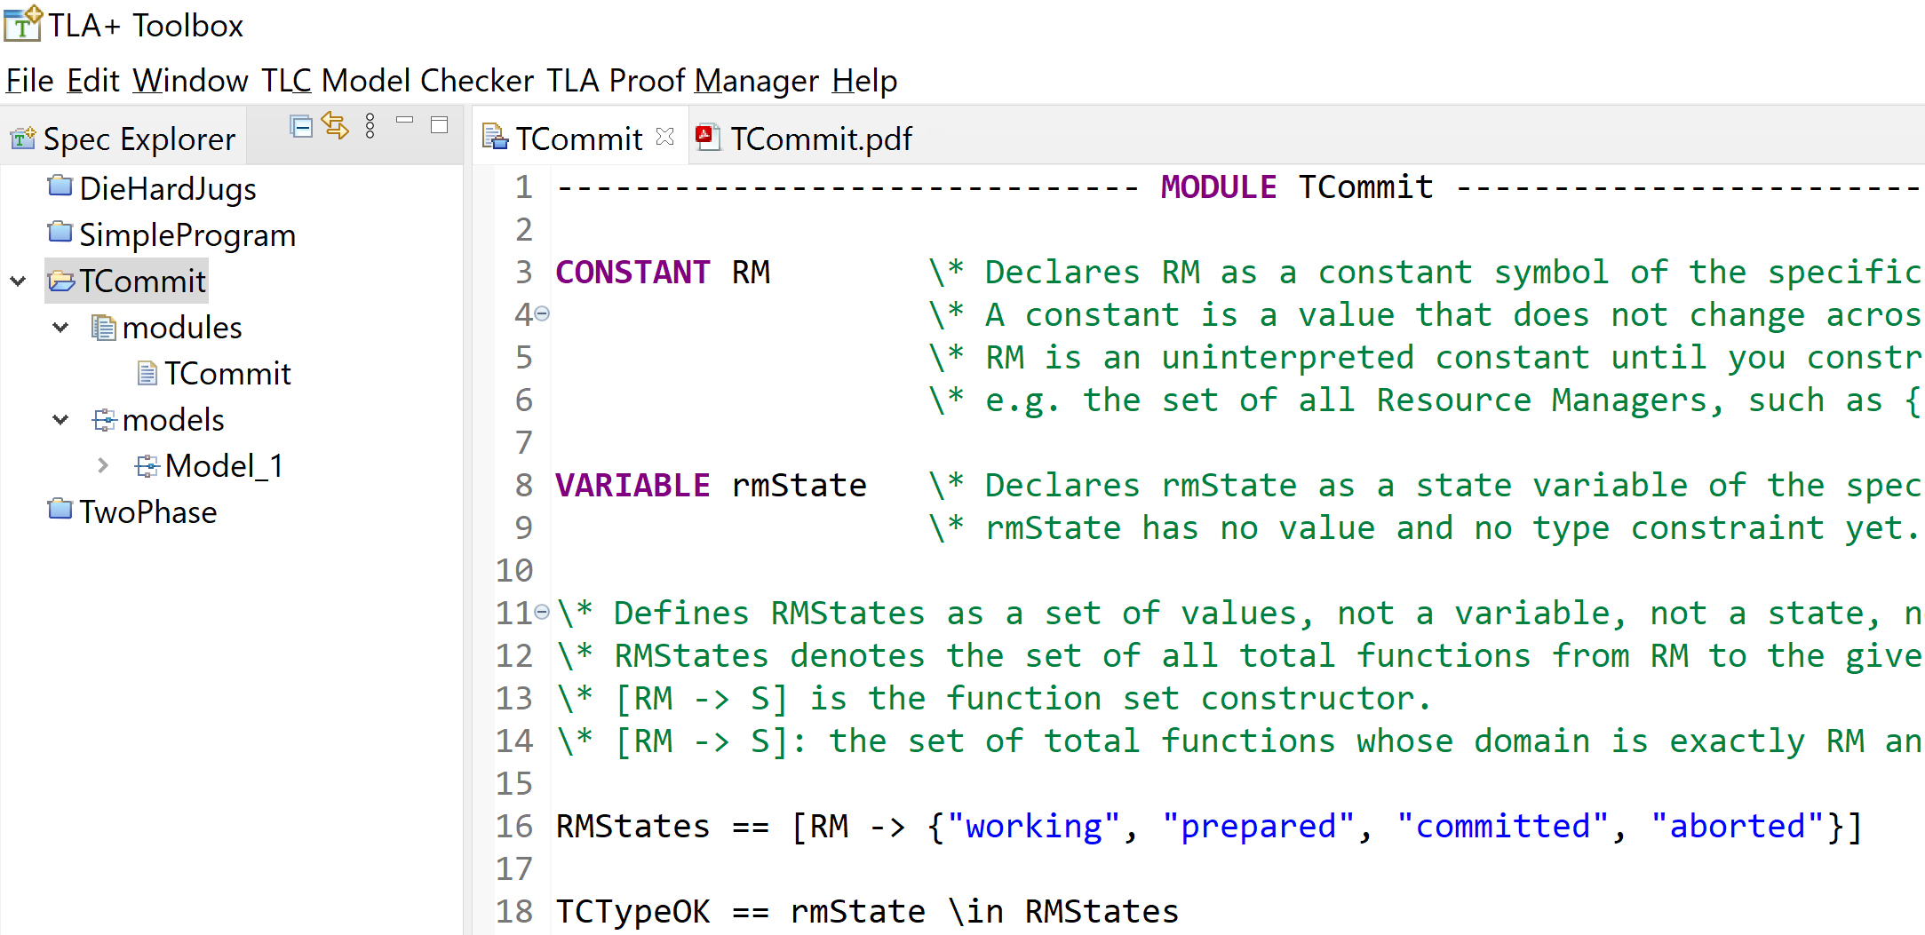
1. Create TCommit Spec

Slide 8
Constants
A constant is a value that does not change across states or over time.
Example:
CONSTANT RM

Slide 9
Functions
A function is an object that maps each element of its domain to exactly one element of its range (often a subset of a codomain).
f : A → B
DOMAIN f = A
f[x] ∈ B for every x ∈ A
Function constructor
rmState = [r1 \in RM |-> "working"]

Slide 10
Function Sets
A function set is a set whose elements are functions.
[ A → B ] = { f ∣ f is a function with domain A and codomain B}
Function set constructor
[RM -> {"working", "prepared", "committed", "aborted"}]

Slide 11
Operator Definition
Example: Prepare(r) ==
Prepare is an operator definition.
Because it is written with a parameter (r), it is a parameterized operator:
Prepare itself is not a value.
Prepare(r) becomes a formula once you supply a value for r.

Slide 12
Action Formula
Prepare(r) is an action formula.
An action is a predicate over a pair of states (s, t).
So Prepare(r) is true of a transition, not of a single state.
t (the next state) can be completely unconstrained. If t is removed then any next state is allowed.

Slide 13
Function Application
Function application is mathematical, not procedural.
f[x] means "the value that the function f assigns to the argument x".
rmState[r] means "the value that the function rmState assigns to the argument r".

Slide 14
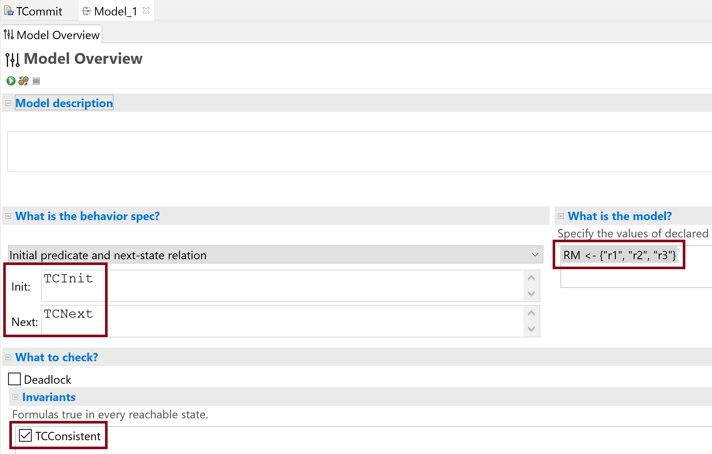
2. Run the Model

Slide 15


Slide 16
The Two-Phase Commit Protocol
Goal: Atomic operations.
Transaction manager.
Resource managers.
Messages.

Slide 17
Possible States and Steps
Transaction Manager states: "init" or "done".
Resource Manager states: "working", "prepared", "committed", or "aborted".
Message types: "Prepared", "Commit", "Abort".
TMRecvPrepared(r): The TM receives a "Prepared" message from resource manager r.
TMCommit: The TM commits the transaction.
TMAbort: The TM spontaneously aborts the transaction.
RMPrepare(r), RMChooseToAbort(r), RMRecvCommitMsg(r), RMRecvAbortMsg(r)

Slide 18
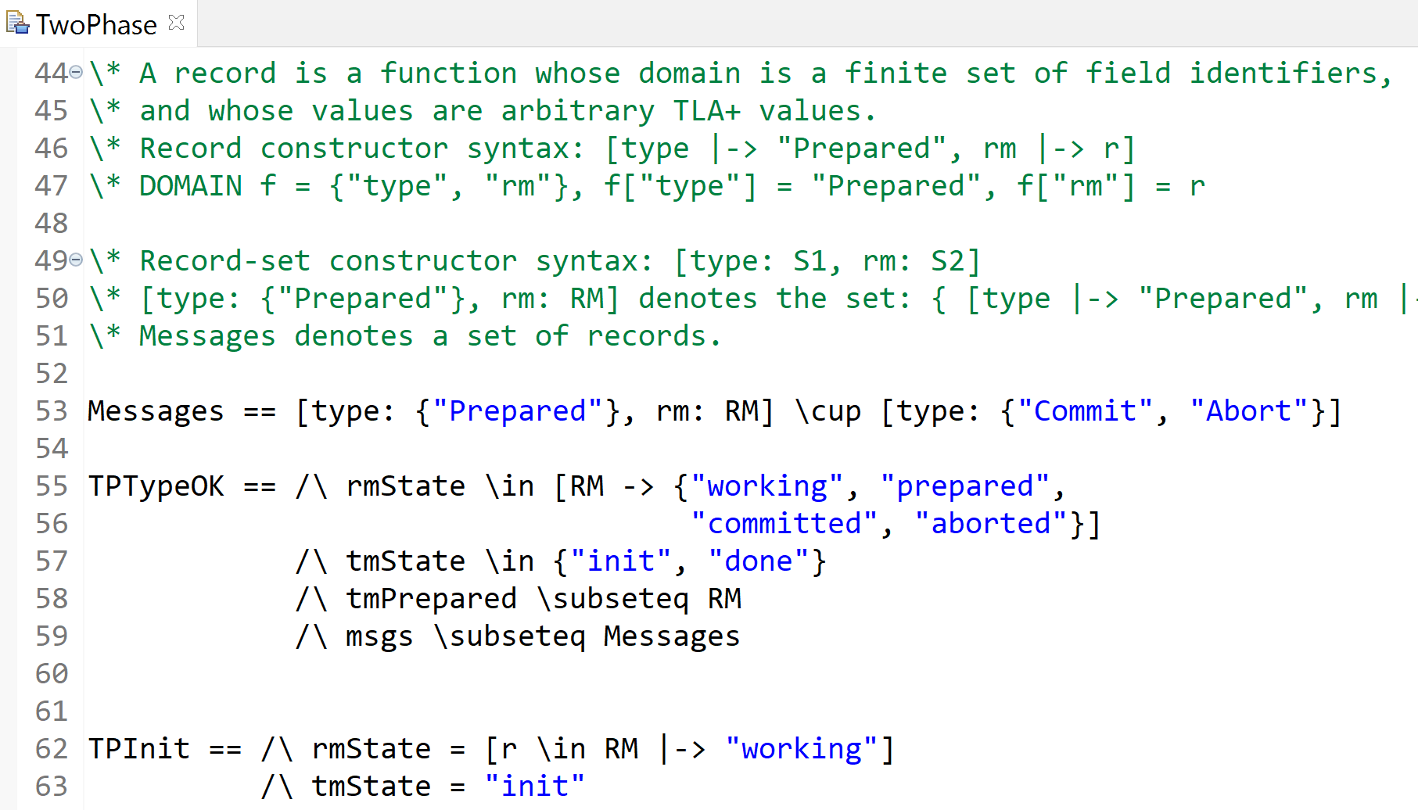
1. Create TwoPhase Spec

Slide 19
Records and Record Sets
A record is a function whose domain is a finite set of field identifiers, and whose values are arbitrary TLA+ values.
Record constructor syntax
[type |-> "Prepared", rm |-> r]
DOMAIN f = {"type", "rm"},
f["type"] = "Prepared", f["rm"] = r
Record-set constructor syntax
[type: S1, rm: S2]
[type: {"Prepared"}, rm: RM]
denotes the set:
{ [type |-> "Prepared", rm |-> x] : x \in RM }

Slide 20
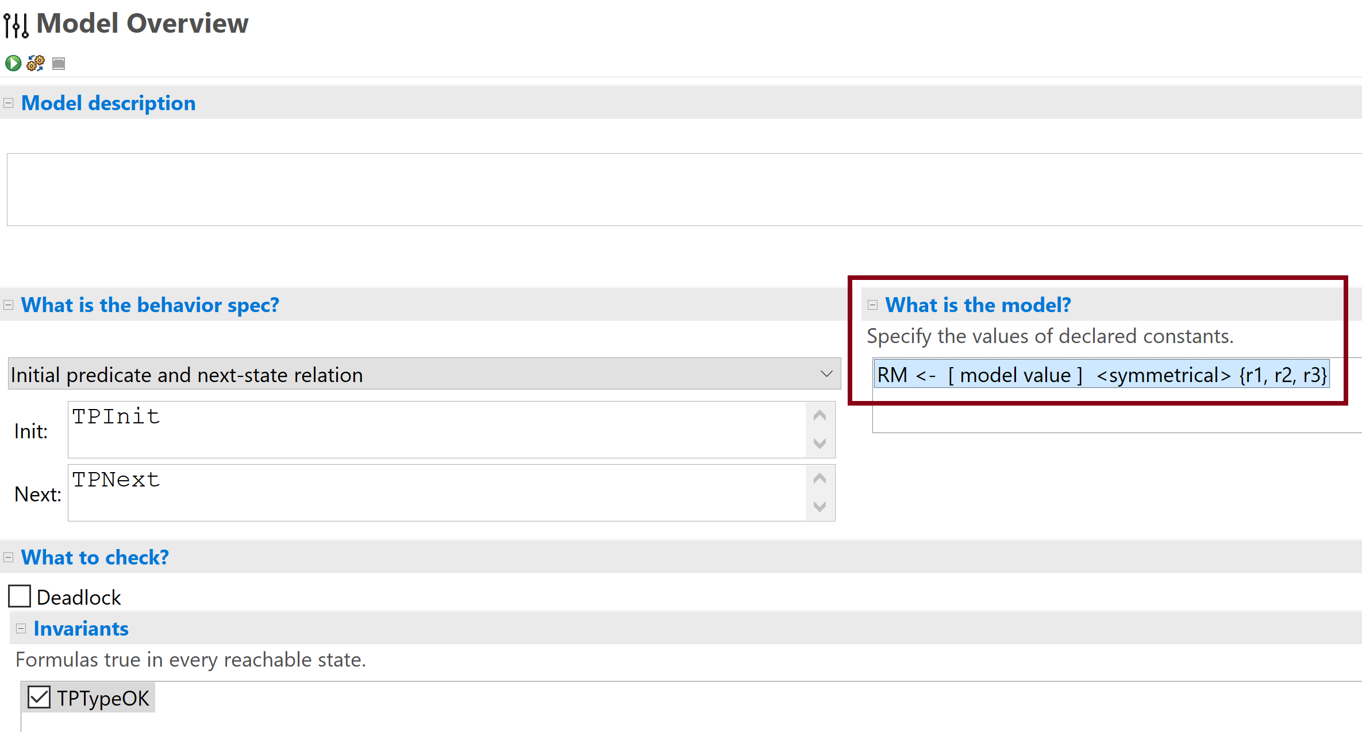
2. Run the Model

Slide 22
The Paxos Commit Protocol
Goal: Atomic operations.
Resource managers.
Acceptors.
Majority.
Ballot numbers.
Messages.

Slide 23
Possible States and Steps

Slide 24
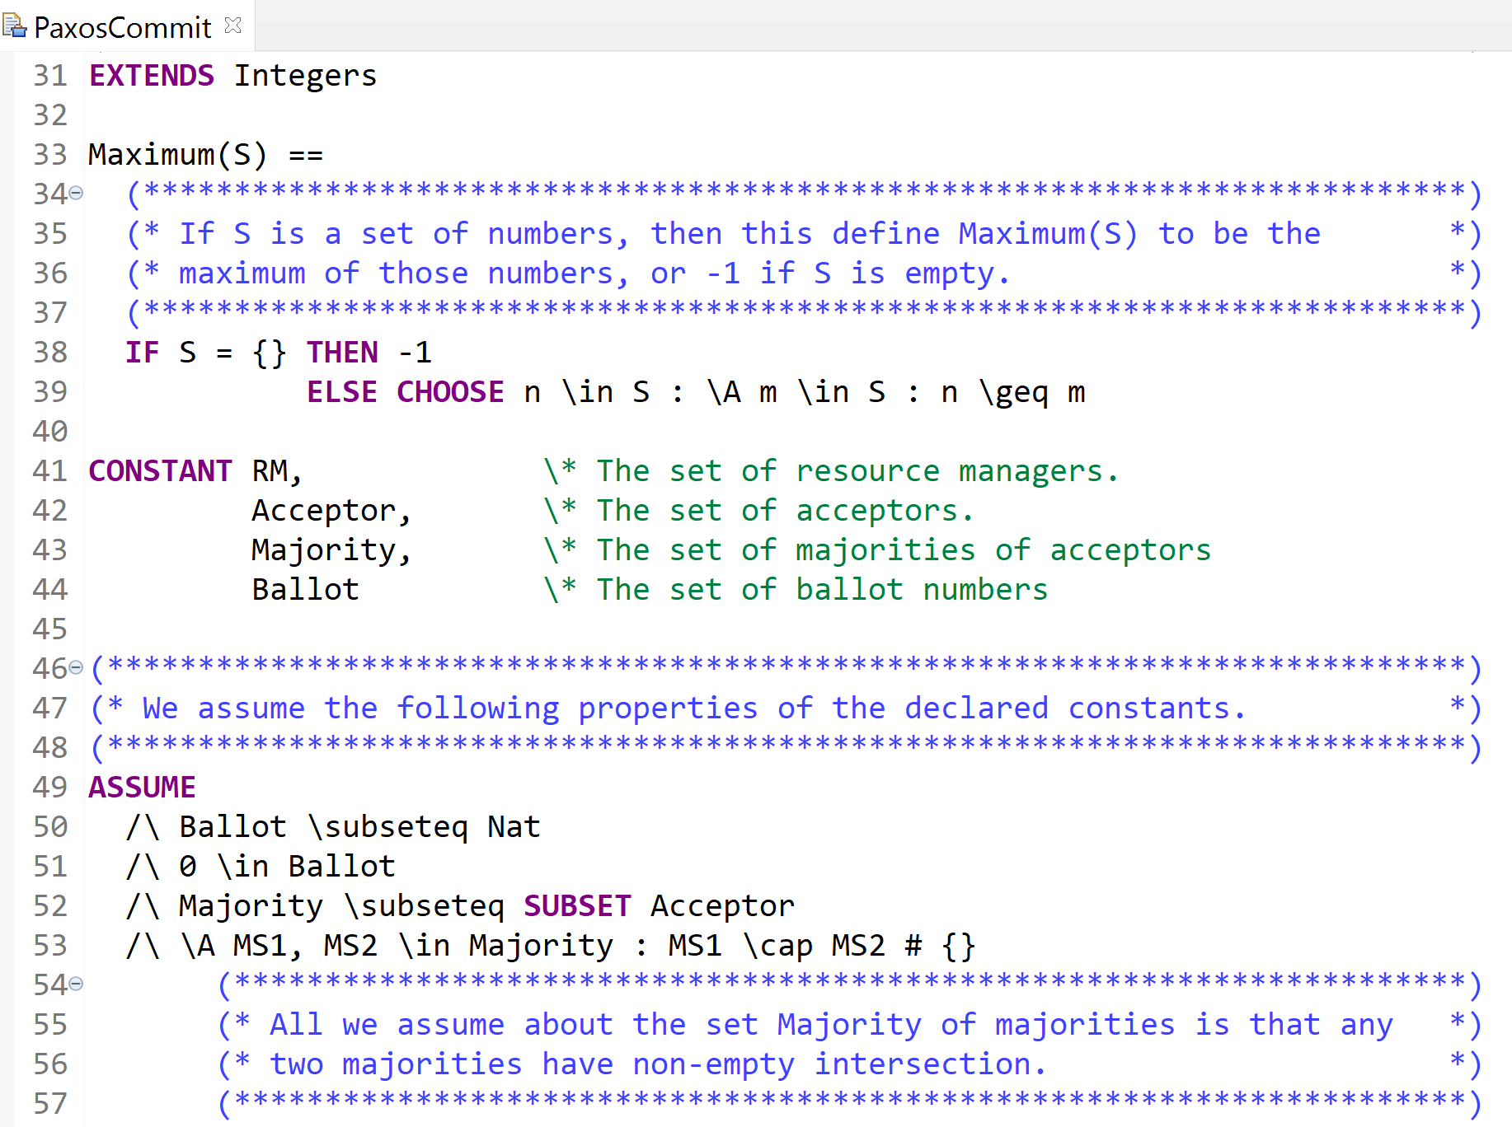
1. Create PaxosCommit Spec

Slide 25
CHOOSE Operator
CHOOSE x:P(x)
means:
some x such that P(x)
It denotes "an arbitrary but fixed value x such that P(x) is true."
CHOOSE is a logical operator that evaluates to a value selected from those satisfying a predicate.
So the result of CHOOSE is always a value, such as: a number, a set, a function, a record, or any other TLA+ value.
CHOOSE is known in logic as Hilbert's ε (epsilon) operator.

Slide 26
ASSUME Declaration
ASSUME is a declaration that states logical assumptions that must be true.
It does not compute anything and does not return a value.
ASSUME expressions are checks to make sure we put in correct constants.
It is a module-level logical declaration
Its purpose is to restrict the allowed values of constants.
ASSUME is meant for constants, not state variables because it defines the allowed universe of the spec.

Slide 27
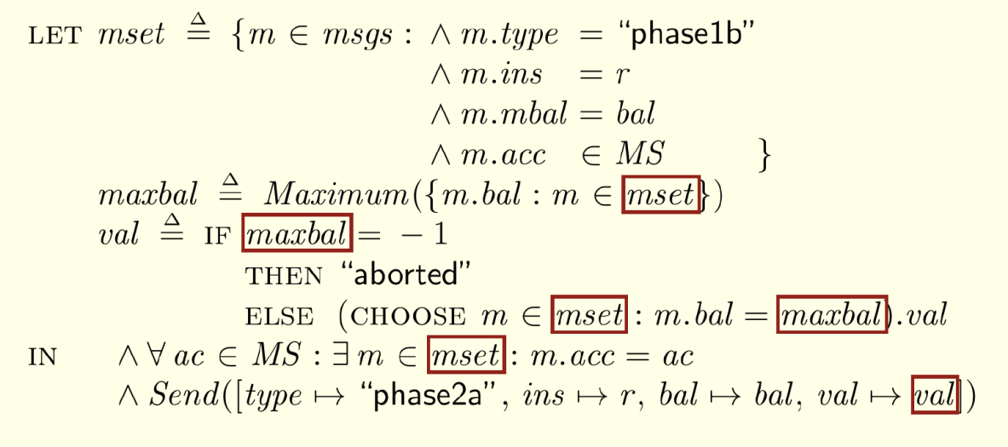
The LET-IN Expression
The LET clause makes three definitions local to the let-in expression.
The defined identifiers can be used only in the expression.

Slide 28
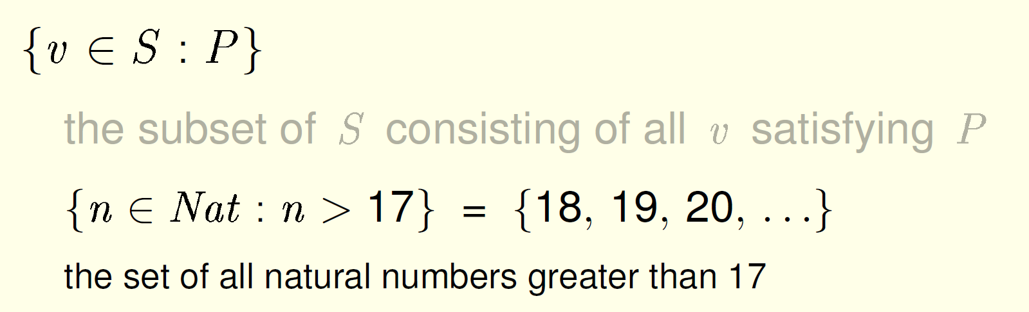
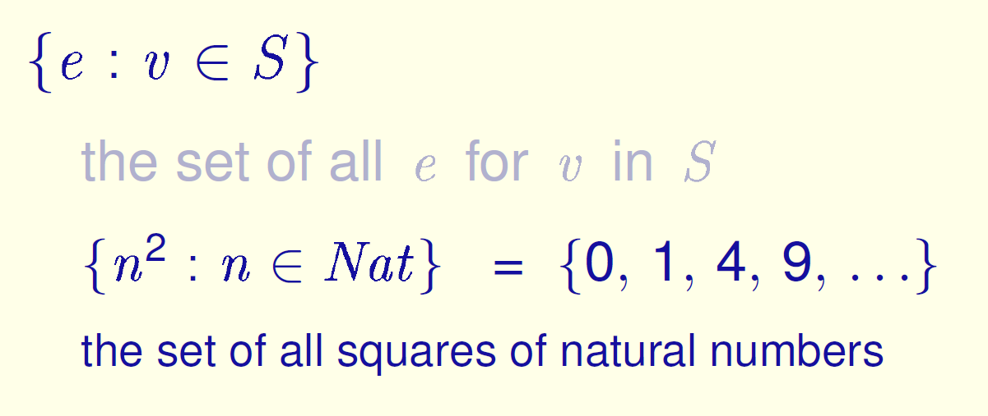
Two Set Constructors

Slide 29
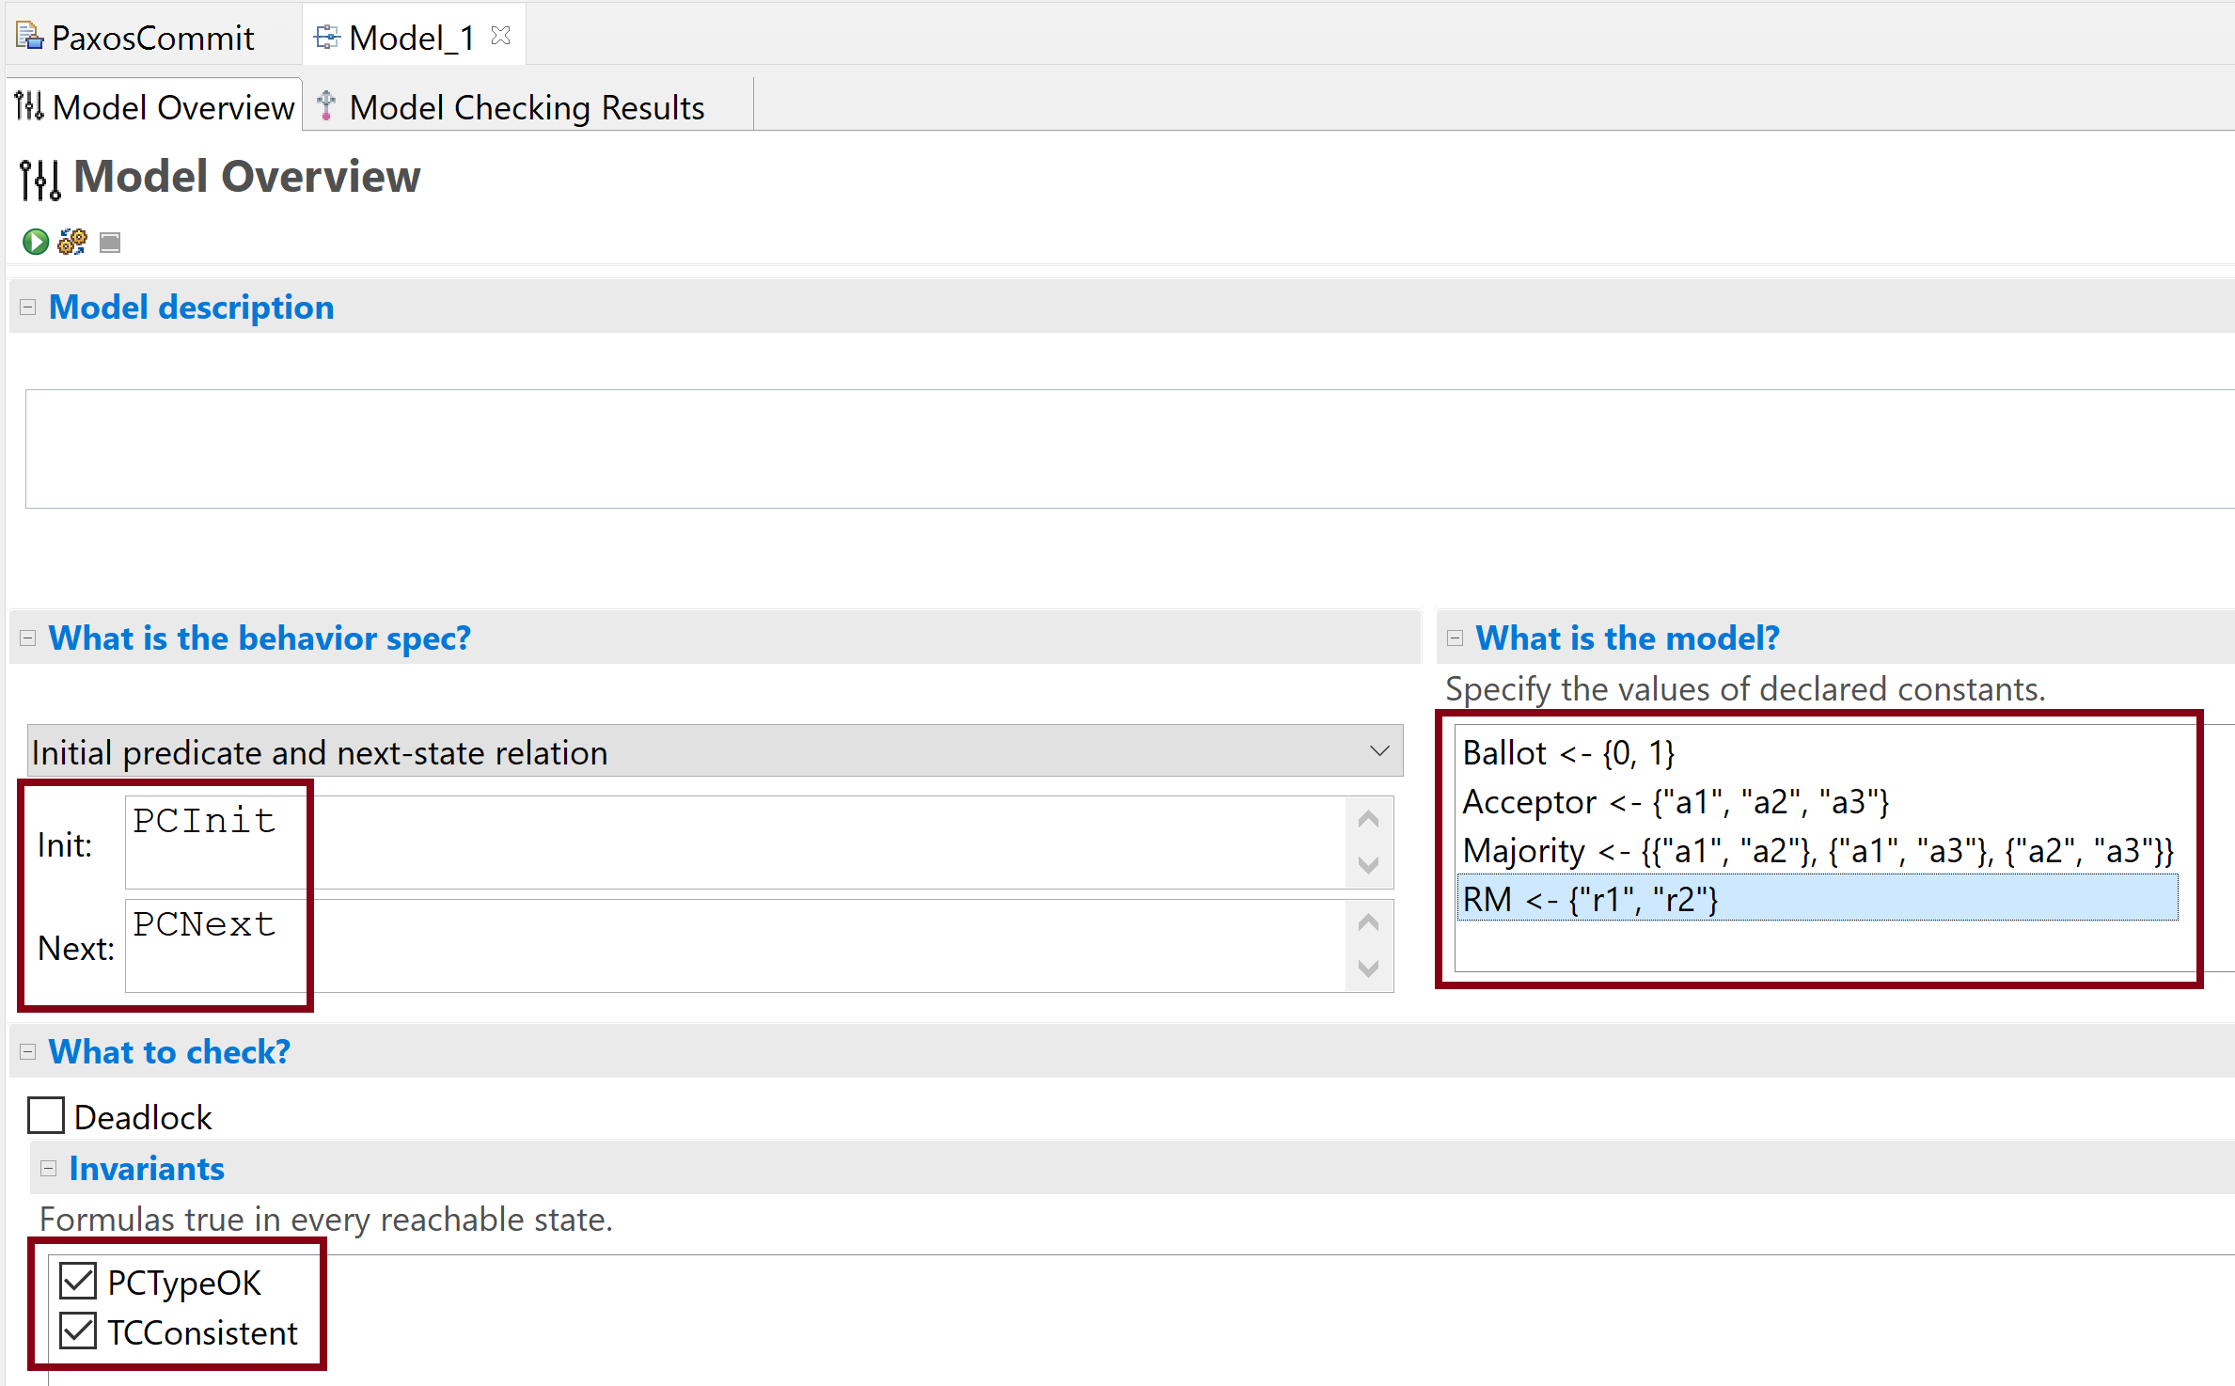
2. Run the Model

Slide 31
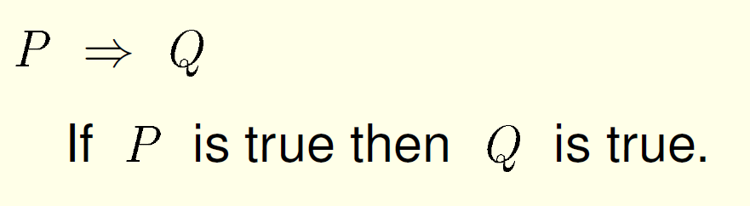
Implication

Slide 32
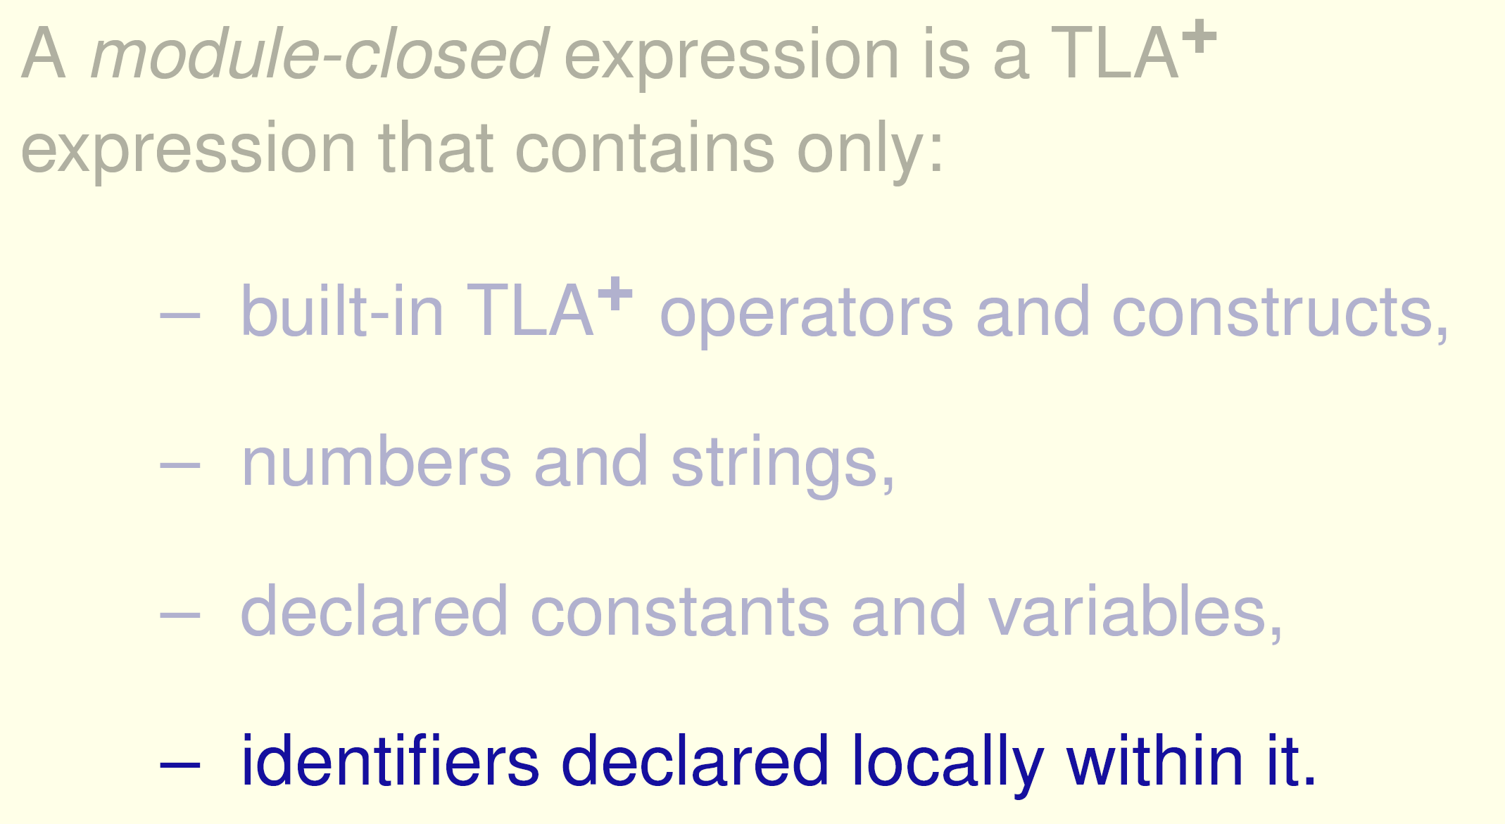
Module-Closed Expressions

Slide 33
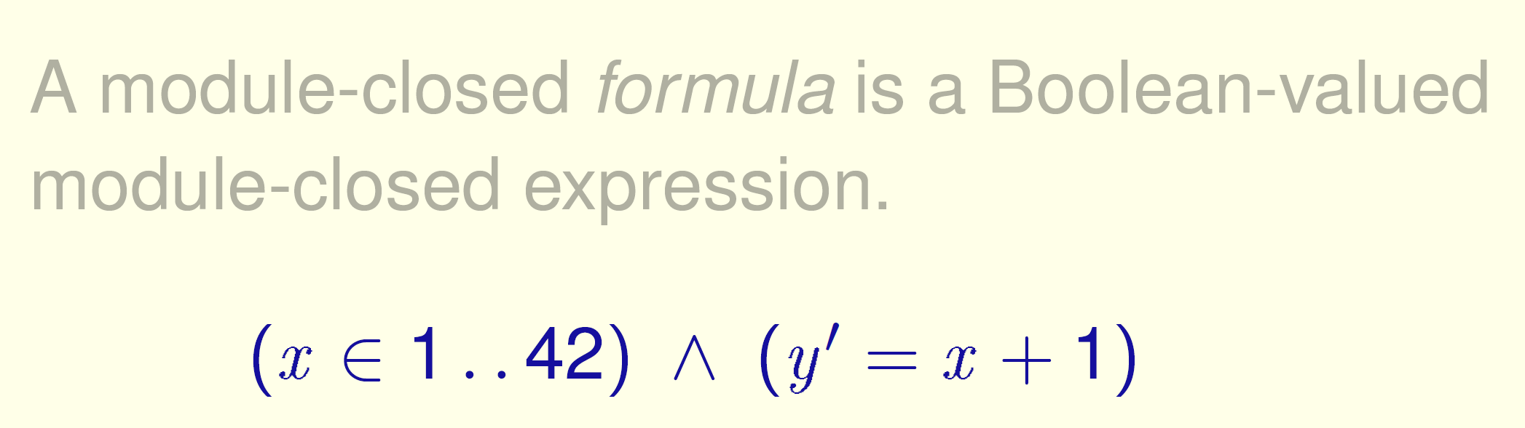
Module-Closed Formulas

Slide 34
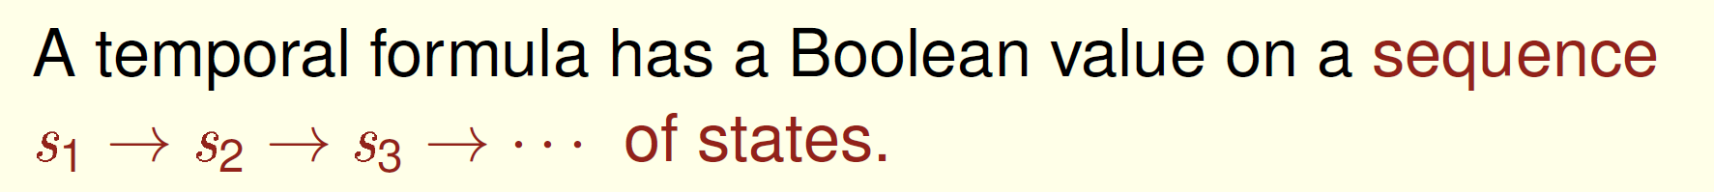
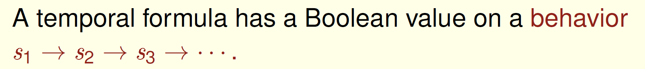
Temporal Formulas

Slide 35
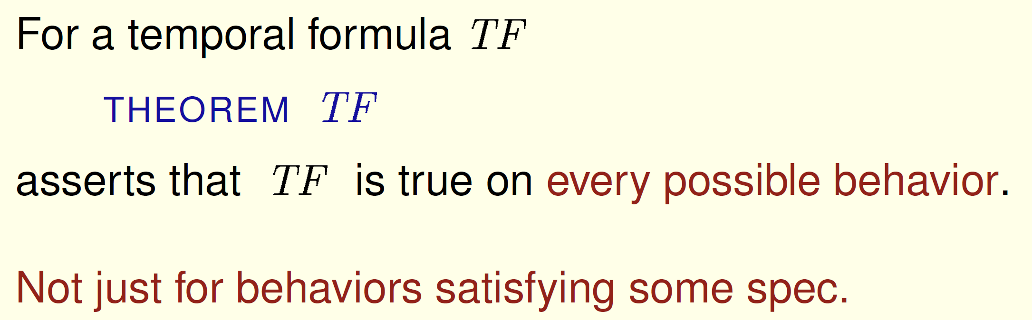
Theorems

Slide 36
Specifications
Specifications are not programs; they're mathematical formulas.
A specification does not describe the correct behavior of a system.
It describes a universe in which the system and its environment are behaving correctly.

Slide 37
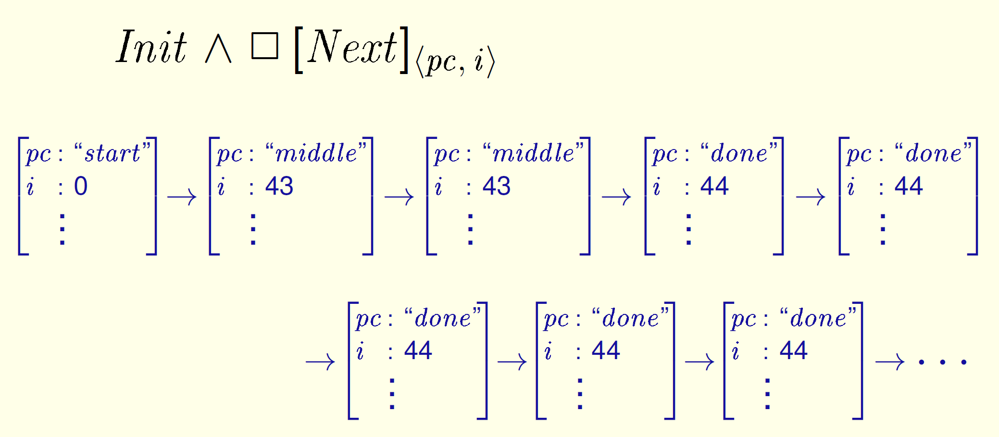
Stuttering Steps

Slide 38
Terminating Execution
We represent a terminating execution by a behavior ending in an infinite sequence of stuttering steps.
The universe keeps going even if the system terminates.
All behaviors are infinite sequences of states.

Slide 40
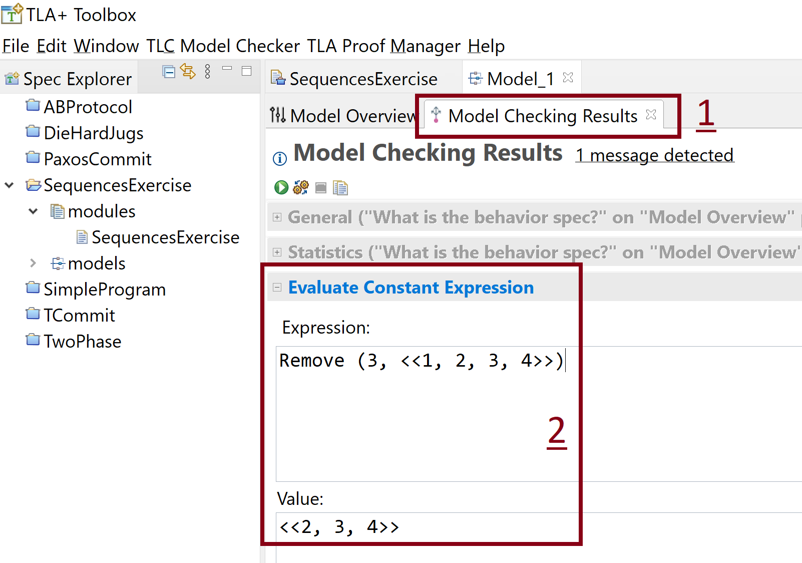
The Sequences Exercise

Slide 41
We represent a terminating execution by a behavior ending in an infinite sequence of stuttering steps.

Slide 42
The Alternating Bit Specification
Goal: Sending messages.
The Cartesian Product.

Slide 43
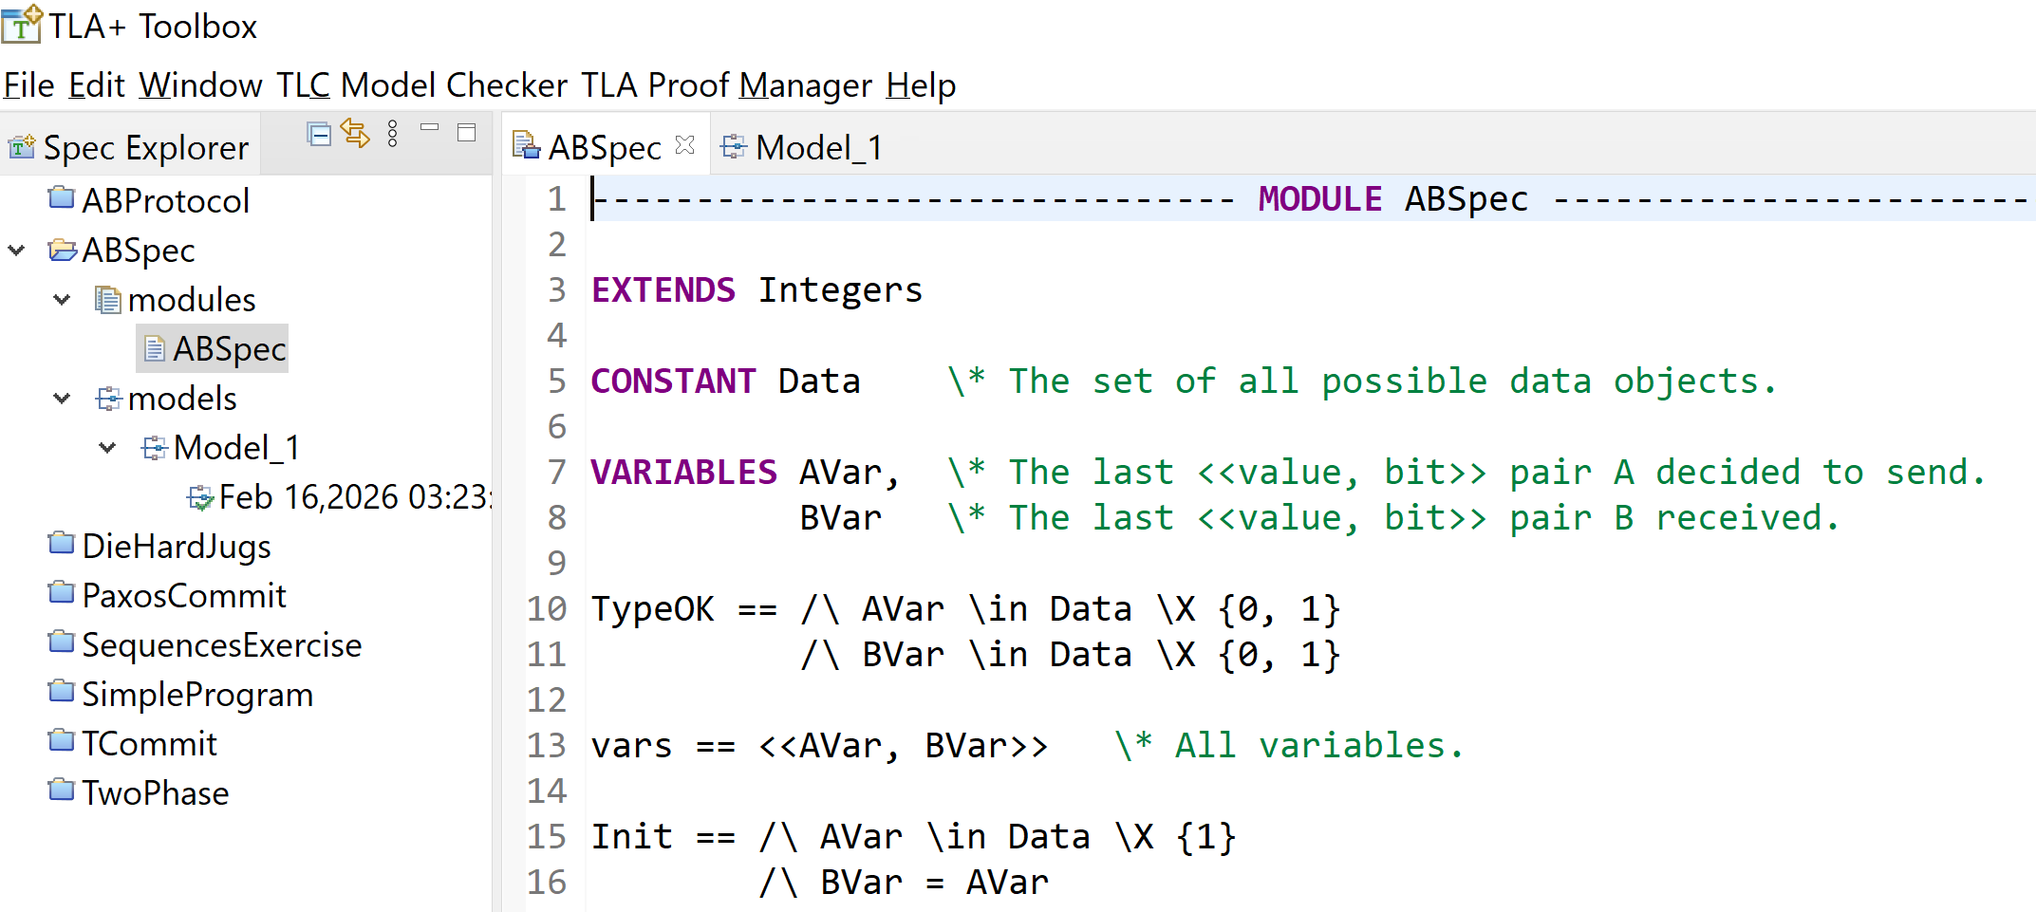
1. Create ABSpec Spec

Slide 44
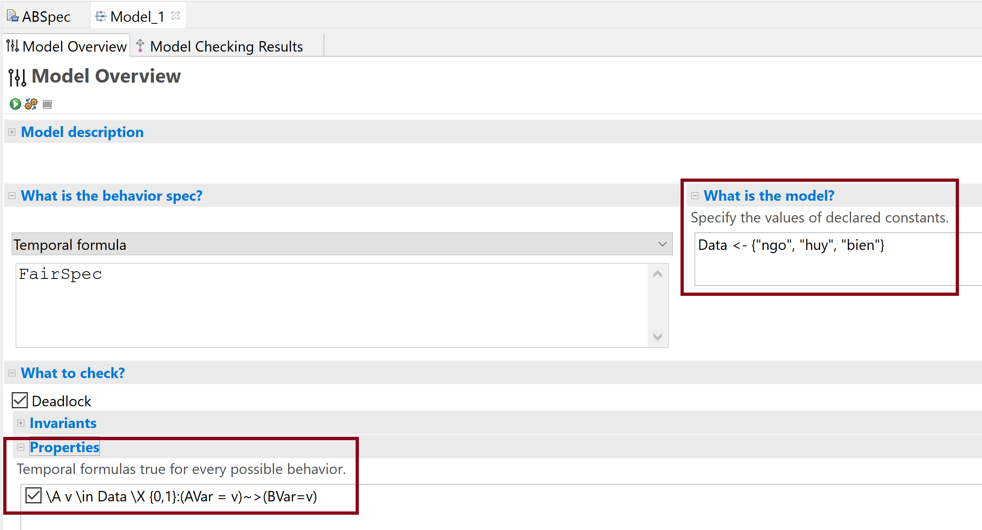
2. Run the Model

Slide 46
TLA+
What it is
A formal specification language based on temporal logic.
What it does
Describes system behavior mathematically
Defines states and state transitions
Expresses safety and liveness properties
Is independent of any particular tool
A TLA+ specification is a temporal logic formula that defines a set of allowed behaviors (infinite sequences of states).
It is declarative and mathematical.

Slide 47
TLC
What it is
A model checker for TLA+ specifications.
What it does
Takes a TLA+ spec
Instantiates constants with concrete values
Explores reachable states
Checks invariants and temporal properties
Produces counterexamples when properties fail
TLC is an executable verification engine.
TLC stands for TLA+ Model Checker.

Slide 48
TLA+ vs. TLC
TLA+ defines what the system is allowed to do.
TLC checks whether a finite instance satisfies desired properties.
TLA+ is infinite-state and mathematical.
TLC is finite-state and computational.
TLC explores bounded models of a potentially infinite specification.

Slide 49
Module vs. Spec vs. Model
A module is a syntactic container — the top-level unit of organization in TLA+.
A spec is a formula (usually named Spec) that defines system behavior over time.
A model is a configuration for the TLC tool. It provides:
Concrete values for constants
Finite bounds for sets
The spec operator to check
Invariants / properties
Symmetry settings
The model is not written in TLA+ syntax; it is a TLC configuration layer.

Slide 50
TLC Model Values
A TLC model value is a symbolic placeholder created using the MODEL VALUE construct in a TLA+ specification.
Example:
CONSTANTS A, B
ASSUME A /= B

Slide 51
TLC Values
A TLC value is any concrete value that the TLC engine can compute with during model checking.
Examples:
Integers (1, 42)
Booleans (TRUE, FALSE)
Strings
Sets ({1,2})
Functions ([x \in S |-> e])
Records ([a |-> 1, b |-> 2])
Sequences (<<1,2,3>>)

Slide 52
Refinement in TLA+
A specification Spec₂ refines Spec₁ if every behavior allowed by Spec₂ is also allowed by Spec₁.
Formally: Spec₂​⇒Spec₁​. This means the concrete system is consistent with the abstract one.
Why This Matters
Refinement allows:
High-level correctness reasoning
Stepwise system design
Safe optimization
Implementation validation

Slide 53
Safety Property
A safety property is a property that asserts: “Nothing bad ever happens.”
Formal Definition
A property P is safety iff:
If a behavior violates P, then there exists a finite prefix of that behavior that already demonstrates the violation.
In other words:
Violations are detectable in finite time.
Once violated, the property cannot be “repaired” later.

Slide 54
Safety Failures
A safety failure: “A bad thing has happened.”
Two processes simultaneously in the critical section. There exists a concrete state: P1InCS = TRUE /\ P2InCS = TRUE
Bank account becomes negative when that is disallowed.
Two leaders exist simultaneously in a consensus system.
Replica states diverge in a way forbidden by the protocol invariant.

Slide 55
Liveness Property
A liveness property is a property that asserts: “Good things eventually happen.”
Let a system behavior be an infinite sequence of states.
A property P is liveness iff:
For every finite prefix of a behavior, there exists an extension of that prefix that satisfies P.
Intuition:
No finite execution can permanently violate a liveness property.
Violations require infinite non-progress.

Slide 56
Liveness Failures
A liveness failure: “That good thing never happens.”
You can never point to a single bad state and say: “Here is the violation.” You must observe endless delay.
Liveness failures are:
Deadlock
Starvation
Infinite retry loops
System makes no progress
Leader never elected
These are progress failures — the system stalls but doesn't necessarily corrupt state.

Slide 58
More TLA+ Examples
https://github.com/felipecrv/tla-course/tree/main
https://old.learntla.com/introduction/
https://mbt.informal.systems/docs/tla_basics_tutorials/tutorial.html

Slide 59

Thank You & See You Again

